Slide 1

Illinois Institute of Technology Laboratory Safety
Fume Hoods

Slide 2
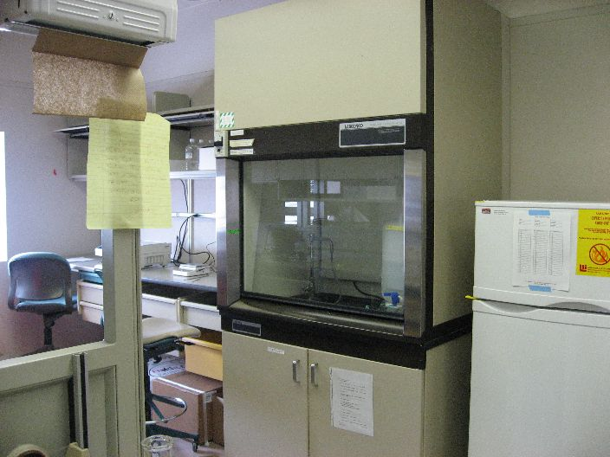

FUME HOODS
FUME HOODS SHOULD BE USED WHEN:
Handling Chemicals With Significant Inhalation Hazards Such As Toxic Gases And Toxic Chemical Vapors.
Chemical Vapors Generated, Could Cause A Fire Hazard.
Working With Volatile Radioactive Materials.
Working With Respirable Toxic Powders.
Carrying Out Procedures With Strong Exothermic Reactions.
Handling Chemicals With Significant Vapor Pressure.
Working With Compounds That Have An Offensive Odor.

Slide 3
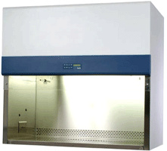
FUME HOODS
HOOD SAFETY RULES - BEFORE USE:
(Continued)
Manufacturer Recommendations Must Be Followed.
If You Haven’t Been Trained In The Safe Use of a Fume Hood You Are Not Permitted To Use It.
Know The Safety Rules Specific To Your Lab And Work Operation.
Know The Hazards With The Materials You Are Using In The Hood.
Know The Limitations Of The Hood You Are Using (Critical).
Understand That Once You Withdraw Your Hands Or Material From The Negative Pressure Area You And Your Coworkers Are Vulnerable.

Slide 4
FUME HOODS
HOOD SAFETY RULES - PERSONAL PROTECTION:
(Continued)
Establish Safety Protocols Before Starting Work.
Know Your Evacuation Procedures.
Know The Hazards Associated With The Materials.
Hand Or Finger Contact With Mucosal Surfaces By Eating, Drinking, Smoking, Applying Make-up, etc., Is Prohibited.
Know Your Specific PPE Requirements.
Use PPE! Gloves, Lab Coats, Masks, And Face/Eye Protection.
Always Wash Hands After Removing Gloves And Before Leaving The Laboratory.

Slide 5
FUME HOODS
Continued
HOOD SAFETY RULES - COMMON USAGE PROCEDURES:
Adjust The Sash To Ensure Proper Airflow Velocities.
Check That The Hood Is Working Properly.
Hoods Must Have A Visual Indicator That Tells The User If The Hood Is Working Properly, Know Your Allowable Readings!
Minimize Storage. Do Not Occupy Space And Block Ventilation By Storing Unused Equipment Or Chemicals In Hoods.
Keep All Work At Least 6 Inches Inside The Hood. Capture Ability Of A Hood May Not Be 100% At The Front.
Never Place Head Inside When Chemicals Are Present.
Never Close Non-bypassed Hoods Completely. Leave At Least A Two-inch Sash Opening.

Slide 6
FUME HOODS
(Continued)
HOOD SAFETY RULES - COMMON USAGE PROCEDURES:
Avoid Cross Drafts. Air Disturbances Can Create Cross Drafts That May Disturb The Direction Of Airflow.
Prevent Pollution. Chemical Vapors Generated In Most Hoods Are Exhausted Into The Atmosphere.
Minimize Pollution. Seal All Chemical Containers Not In Use. Never Use The Hood To Vent Excess Chemical Waste.
Keep The Hood Clean. Remove Old Experimental Glassware And Clutter. Wipe Up Spilled Chemicals Or Residues.
Ensure You Can See Through The Glass Sash.
Never Heat Perchloric Acid In Standard Fume Hoods. Vapors May Create Explosive Perchlorates In The Ductwork.
Do Not Adjust The Damper.

Slide 7
FUME HOODS
(Continued)
HOOD SAFETY RULES - WORK TECHNIQUES:
Perform Routine Safety Checks During “Start-up”.
Know The Air Flow Requirements For Safe Usage.
Follow Approved Procedures.
Keep Sashes Down.
Don’t Store Flammable Liquids, Or Equipment In Hood.
Confirm Adequate Hood Performance Before Use.
Keep Hood Closed, Except When Necessary.
Keep Materials Stored In Hoods To A Minimum.
Do Not Allow Materials To Block Vents Or Air Flow.
Ensure You Do Not Have Incompatible Materials In Unit.

Slide 8
FUME HOODS
(Continued)
HOOD SAFETY RULES - WORK TECHNIQUES:
Leave The Hood “ON” When:
It Is in Active Use.
If Toxic Substances Are Stored in It.
If It Is Uncertain Whether Adequate General Laboratory Ventilation Will Be Maintained When It Is “OFF.”

Slide 9
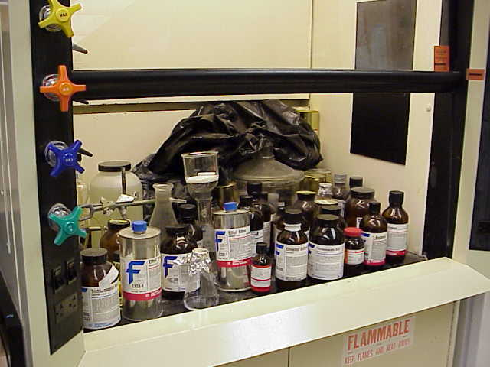
FUME HOODS
(Continued)
CHEMICAL STORAGE AND SAFETY - FUME HOODS:
Never Use Fume Hoods As Storage Cabinets.
ALWAYS FOLLOW LOCAL PROCEDURES

Slide 10
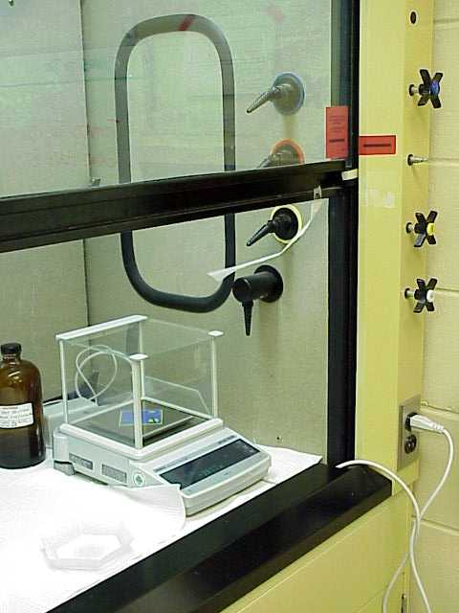
FUME HOODS
(Continued)
CHEMICAL STORAGE AND SAFETY - FUME HOODS:
Many Fume Hoods Have Air Flow Alarms. However, Alarms Occasionally Fail Or Are Deliberately Silenced.
Tape A Tissue To The Fume Hood Sash To Provide A Visual Indication Of Air Flow.
ALWAYS FOLLOW LOCAL PROCEDURES

Slide 11
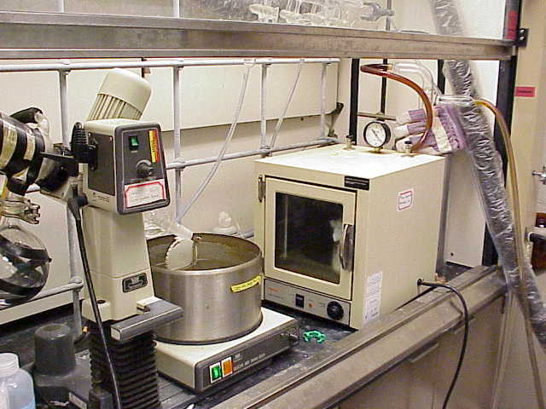

FUME HOODS
(Continued)
CHEMICAL STORAGE AND SAFETY - GENERAL:
It’s Important Not To Block Fume Hood Air Flow.
When Large Equipment Is Placed In A Fume Hood, Place It On Blocks Or Racking To Allow Air Flow Under The Equipment.
ALWAYS FOLLOW LOCAL PROCEDURES

Slide 12
FUME HOODS
(Continued)
Summary:
If you need further assistance with Fume hood safety watch Fume hood safety Dos and Don’ts by LabConco at: http://www.youtube.com/watch?v=yqU5bGP0i5I
Call the Department of Environmental Health and Safety at (312) 567-3084.

